Slide 1
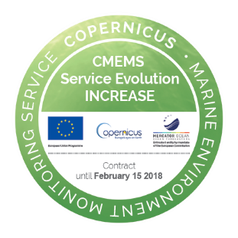

INCREASE HF Radar
Users Workshop
HF radar applications
INCREASE
HF Radar
Users
Workshop
26th
September 2017
Outline
    General view of HF Radar applications
    Examples of HFR applications
    HFR data uses and users in Europe
    Final remarks
    Courtesy of L. Wyatt and E. Zambianchi
CMEMS Service Evolution 21-SE-CALL1
Lot5: INCREASE project
Innovation and Networking for the integration of Coastal Radars into European mArine SErvices

Slide 2
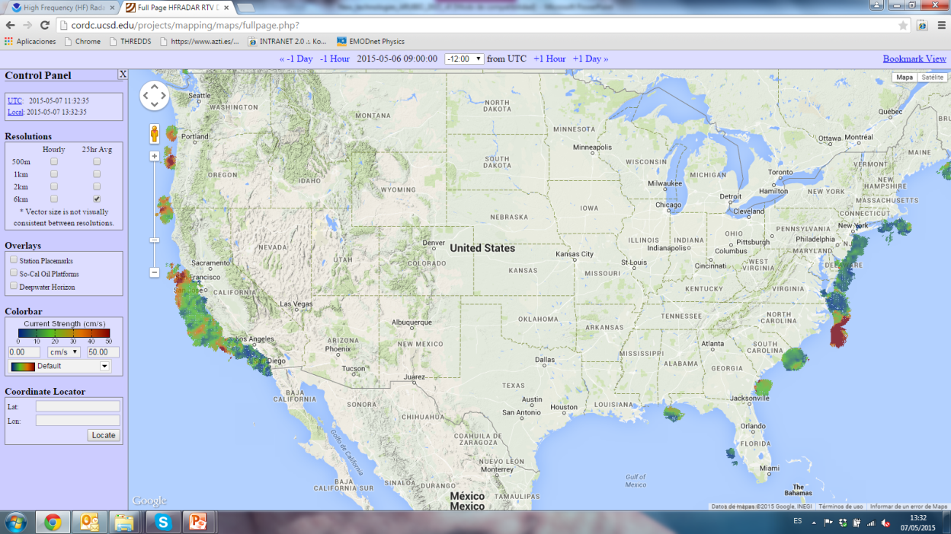
General view of HFR systems applications
HFRs being used worldwide for several applications… and growing number
INCREASE
HF Radar
Users
Workshop
26th
September 2017
USA
(Paduan and Washburn, 2013 -Annual Review of Marine Science )
EUROPE
(Rubio et al., 2017 – Frontiers in Marine Systems)
Asia and Oceanie
(Fujii et al. 2013 – Ocean Science Journal)

Slide 3
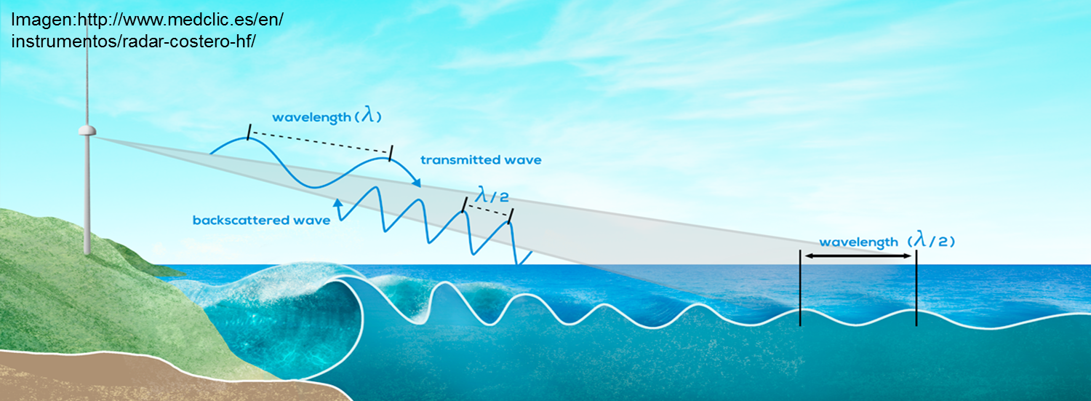
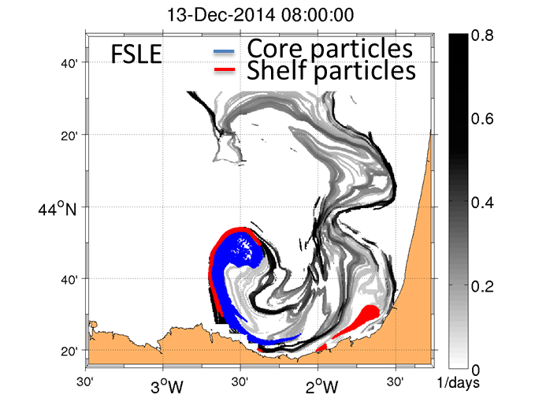
General view of HFR systems applications
Direct use of data:
- UV fields, waves, wind direction, discrete targets
Derived products:
-Lagrangian models, gap-filled data…
Near real time or operational use of the data:
-study of surface drift of floating objects
-statistical methods for short term prediction
-model-data comparisons or data assimilation in models…
INCREASE
HF Radar
Users
Workshop
26th
September 2017
Long term data series and/or data exploitation:
- study of ocean processes: inertial oscillations, tidal variability, (sub)mesoscale coastal processes,
- connectivity between marine areas
-air-sea interactions…
Rubio et al. Under review for RSE

Slide 4
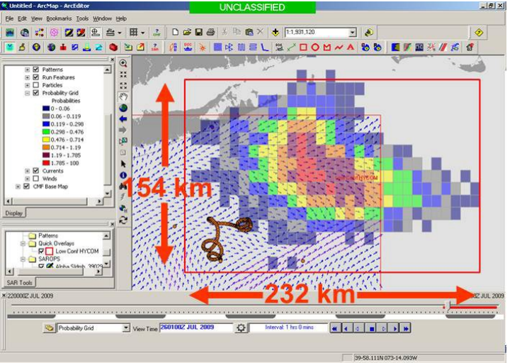
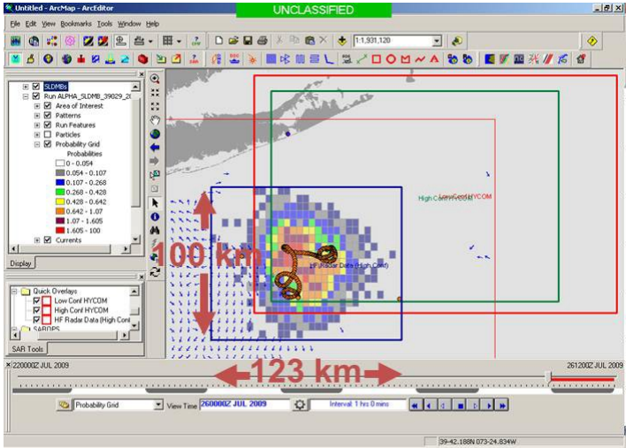
Near real time applications
Study of surface drift of floating objects: SEARCH AND RESCUE
INCREASE
HF Radar
Users
Workshop
26th
September 2017
HF Radar in SAROPS (US Coast Guard SAR tool)
Source: http://www.ioos.noaa.gov/hfradar/sarops_hfr_info2012.pdf
HYCOM
HF RADAR

Slide 5
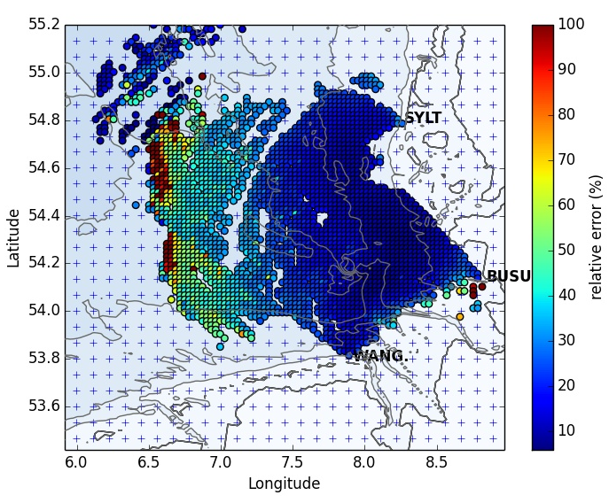

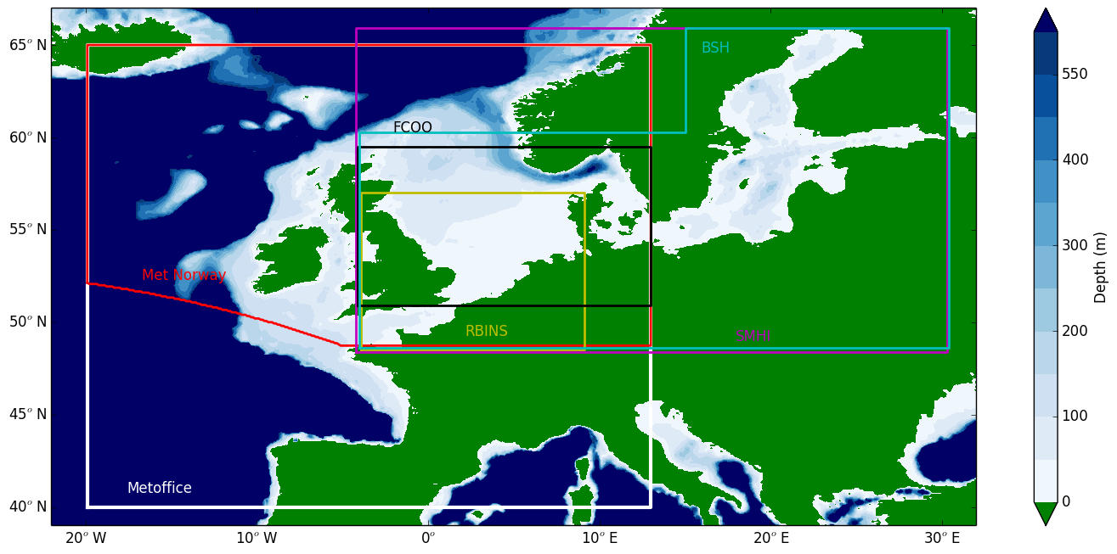
Surface currents forecast operational verification using HF radar
Christine Pequignet, Jan Maksymczuk,
Met Office Ocean forecast verification team
Near real time applications
Model-data comparisons or data assimilation in models
INCREASE
HF Radar
Users
Workshop
26th
September 2017
Verification of Met Office operational ocean surface currents forecast using HF radar data is being developed
In parallel, a multi-model verification of European models on the European North West shelf is implemented, initially using the German Bight COSYNA data.
The work will be extended to include more European HF radar datasets
3 month average of relative error of surface current magnitude from COSYNA HF radar (German Bight)
Plans for verification of 5 day forecasts for the overlapping area of IBI, Mercator PSY4 and Met Office FOAM-AMM7
Domains from models used in the multi-model verification over the European NWS

Slide 6
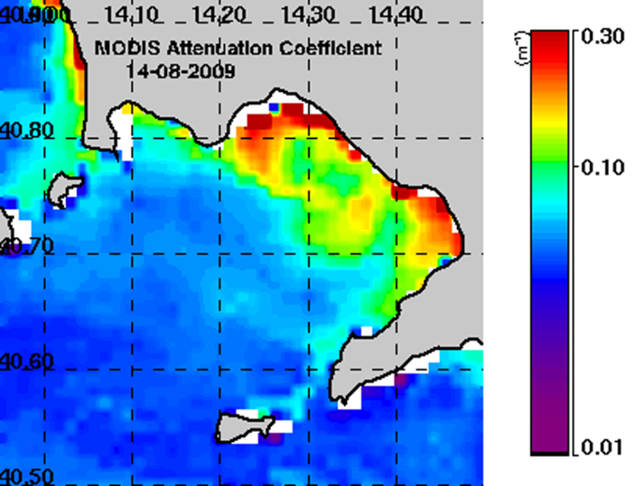
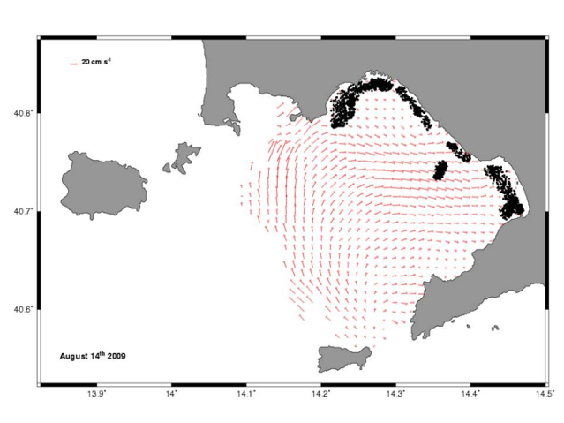
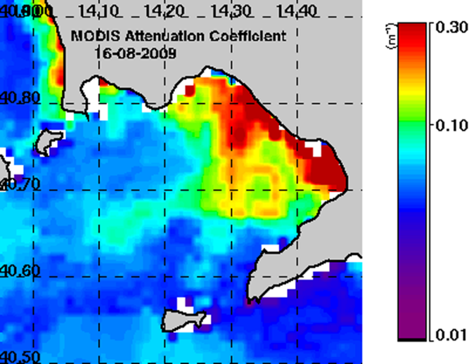
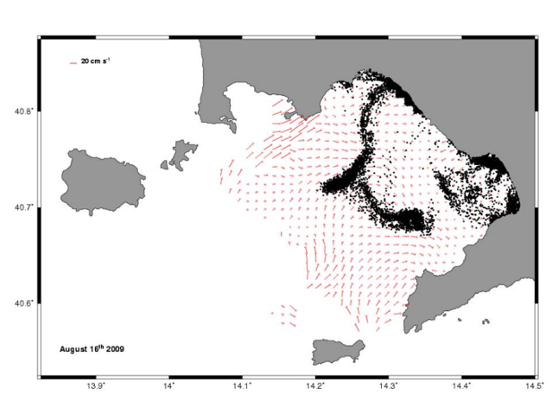
Long term data applications
Lagrangian studies and connectivity between marine areas
Combined use of HF radar and satellite data to study the dynamics in the Gulf of Naples. Enrico Zambianchi et al. (DiSAm, Parthenope University of Napoli)
INCREASE
HF Radar
Users
Workshop
26th
September 2017
2 days later…

Slide 7
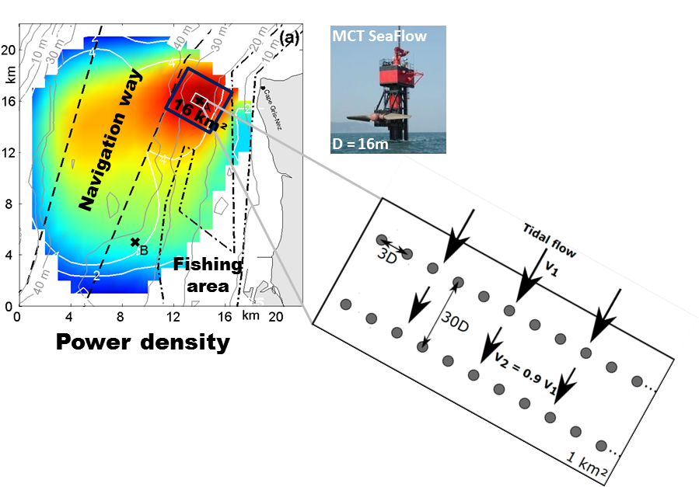
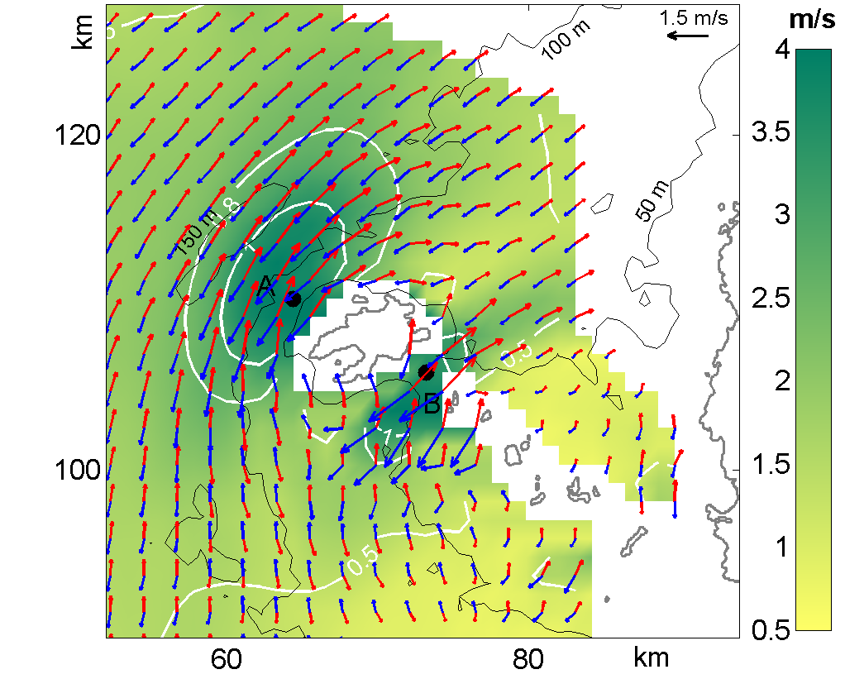
Long term data applications
Ocean processes
THE USE OF HF RADARS FOR MONITORING STRONG TIDAL CURRENTS IN STRAITS AND ASSESSING TIDAL STREAM RESOURCE
A new way of resource assessment
Alexei Sentchev, Maxime Thiébaut (Lab. Oceanology & Geosciences - LOG, Université du Littoral, FRANCE
INCREASE
HF Radar
Users
Workshop
26th
September 2017
Fromveur Strait
Expected technically expoitable potential:
One MCT SeaFlow device: P_{tech} = 0.6 GWh
An array of 32 tidal turbies : P_{tech} = 15 GWh
Array location is very important beacause the variation of current asymmetry is strong
Flood/Ebb tidal HFR currents in Fromveur area
A total of 32 tidal turbines (MCT SeaFlow 0.6 MW) over 1 km², west of the Cape Gris Nez (Hauts de France), facing the flow
(e.g. Blunden & Bahaj, 2007)

Slide 8
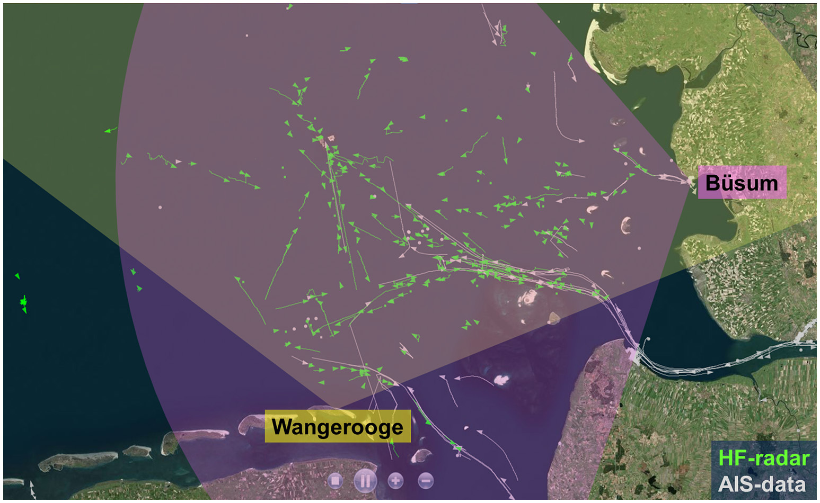
Other applications
Ship detection
INCREASE
HF Radar
Users
Workshop
26th
September 2017
Map of ship detections in the German Bight resulting from fusion of HFRs at Wangerooge and Büsum covering the German Bight of the southern North Sea.
(J. Horstmann in Rubio et al. 2017, FMS)

Slide 9
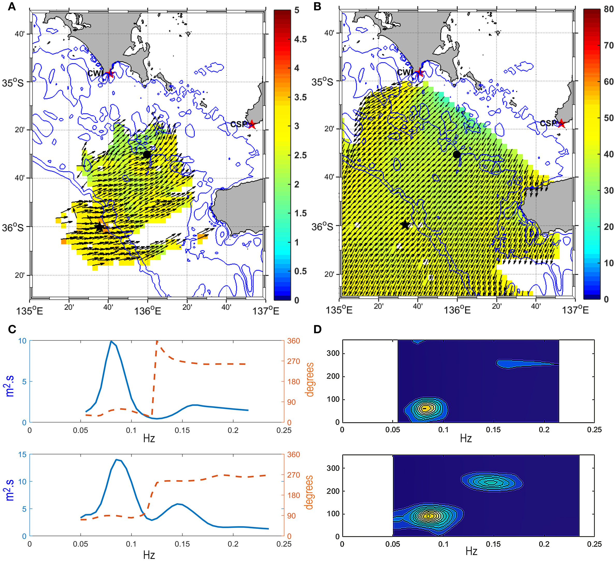
Other applications
Wind and wave data
Signiﬁcant wave height (m) and peak direction
Wind direction and
directional spreading (degrees)
INCREASE
HF Radar
Users
Workshop
26th
September 2017
Example of HFR-derived wave data (28/06/2011 02:00) in South Australia showing a bimodal sea state (SW swell from and local sea
from the E and winds from NE)
Frequency spectrum (blue) and mean direction at each frequency (red) at two locations,
one in shallower seas (top, black dot on the maps A,B) and the other (bottom, black star on the maps A,B) near the shelf edge
Directional spectra (spectral density, in m2.s.radian-1).
(L. Wyatt in Rubio et al. 2017, FMS)

Slide 10
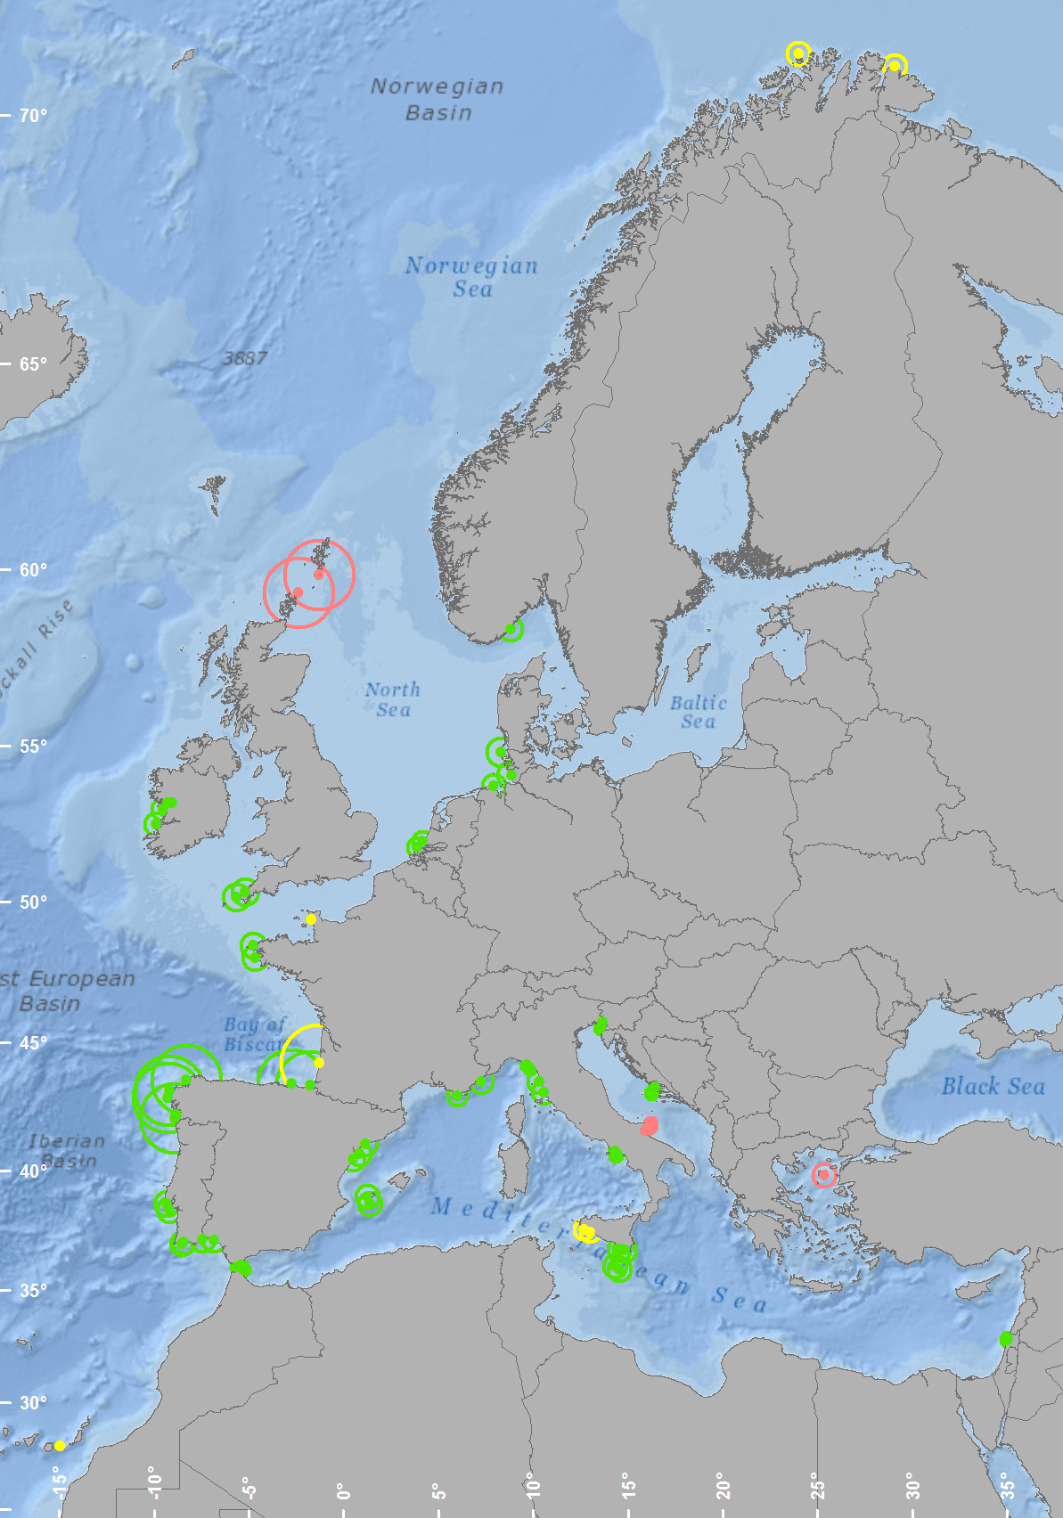
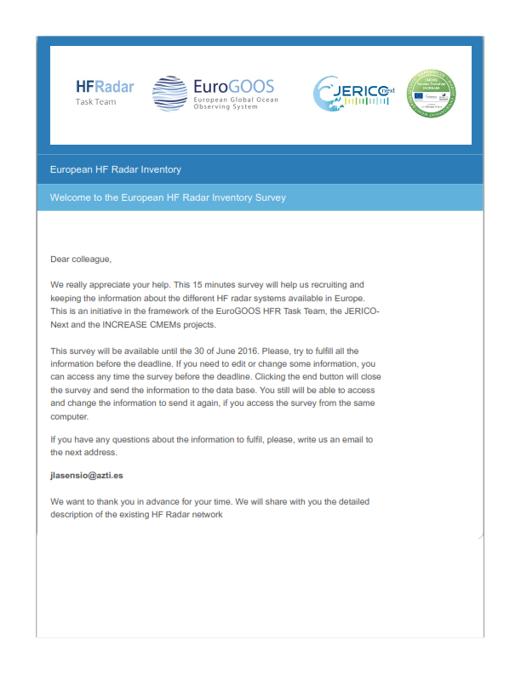
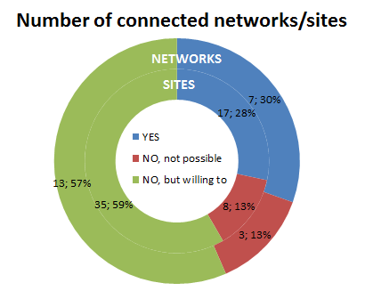
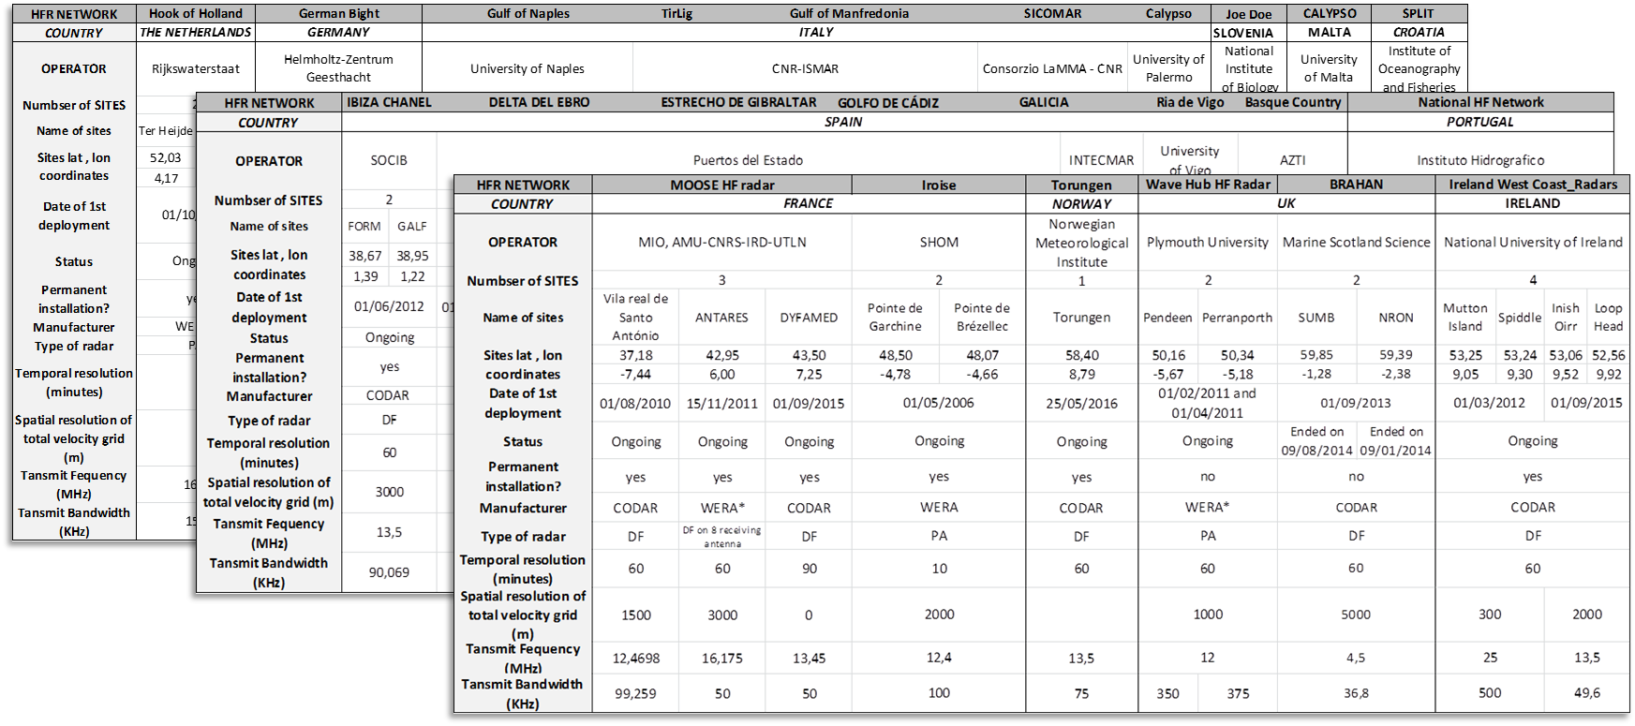
HF Radar applications in Europe
INCREASE
HF RADAR survey
July 2016
INCREASE
HF Radar
Users
Workshop
26th
September 2017
28 institutions, 23 operators of ongoing or past HFR networks.
72 sites (28 networks), 51 operational (20 networks).
MONGOOS 31 sites (52%)
IBIROOS 17 sites (28%)
NOOS 12 sites (20 %)
CMEMS Service Evolution 21-SE-CALL1
Lot5: INCREASE project
Innovation and Networking for the integration of Coastal Radars into European mArine SErvices

Slide 11
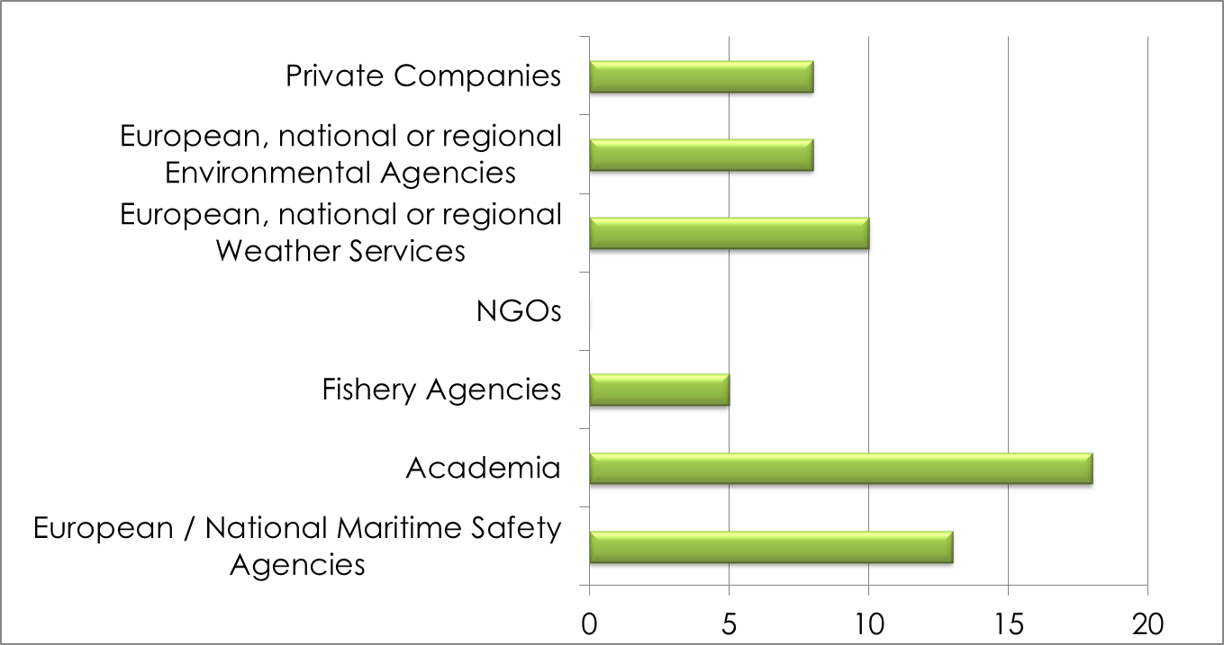
HF Radar applications in Europe
HFR main identified users in Europe
INCREASE
HF Radar
Users
Workshop
26th
September 2017
EU HFR identified users. From the 23 networks 20 chose at least one option. Multiple choice was enabled, so more than one user could be identified by the same operator.
CMEMS Service Evolution 21-SE-CALL1
Lot5: INCREASE project
Innovation and Networking for the integration of Coastal Radars into European mArine SErvices

Slide 12
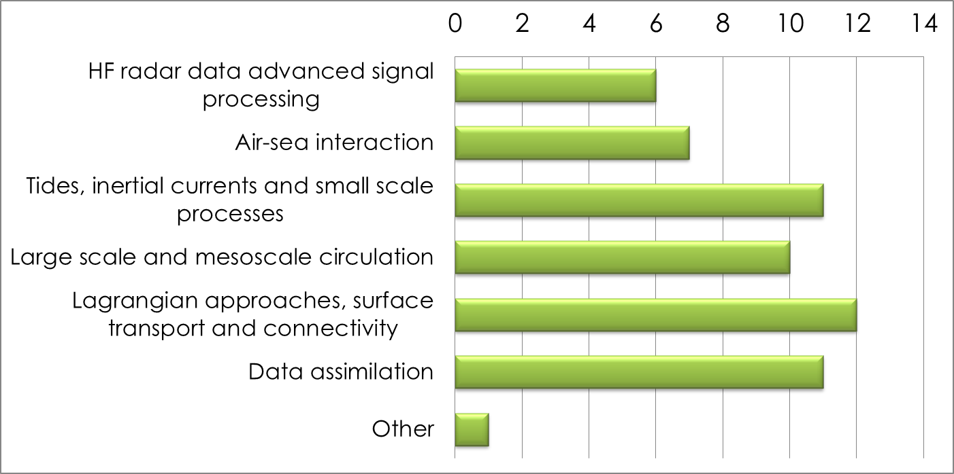
HF Radar applications in Europe
HFR main related research lines
INCREASE
HF Radar
Users
Workshop
26th
September 2017
HFR related Research Lines listed by EU operators contributing to the survey. From 23 operators 15 chose at least one of the available options. Multiple choice was enabled, so more than one application within the same or different sectors could be identified by the same operator.
CMEMS Service Evolution 21-SE-CALL1
Lot5: INCREASE project
Innovation and Networking for the integration of Coastal Radars into European mArine SErvices

Slide 13
HF Radar applications in Europe
HFR current data uses and users
INCREASE
HF Radar
Users
Workshop
26th
September 2017
EU HFR applications within four activity sectors. From 23 operators 14,7, 11 and 12 chose at least one of the available options for a), b), c) and d), respectively.
CMEMS Service Evolution 21-SE-CALL1
Lot5: INCREASE project
Innovation and Networking for the integration of Coastal Radars into European mArine SErvices

Slide 14
INCREASE HF Radar
Users Workshop
HF radar applications
INCREASE
HF Radar
Users
Workshop
26th
September 2017
Final remarks
1 - HFRs offer an unprecedented opportunity to take a step forward in the understanding of coastal ocean processes and transport mechanisms along the European coasts
2- Increasing applications of HFR in notable issues like the Marine Strategy Framework Directive (MSFD), the sustainable development of the Blue economy or the maritime safety (Most commonly identified users: Academia and Marine Safety agencies)
3 -To reach the potential that this technology can offer to the European coastal operational oceanography, the HFR and EOOS community need to elaborate a broad plan towards the establishment of a real and effective European HFR Network, in coherence with the existing initiatives at international levels.
CMEMS Service Evolution 21-SE-CALL1
Lot5: INCREASE project
Innovation and Networking for the integration of Coastal Radars into European mArine SErvices

